Slide 1
Heart Disease Prediction
By : Sahil Rahi
Kajal Sharma
Shanel Pinto
Chinju Baby
Elda Varghese

Slide 2
Prelude
The objective of the project was to apply machine learning solutions to the given processed Cleveland dataset for detecting the presence of heart disease in a person and checking the accuracy of the algorithms.

Slide 3
Process Requirements
Download & Install the software Anaconda, Python, libraries etc.
Import the libraries in python.
Start the environment and import the dataset into it.

Slide 4
Machine Learning process
Importing the dataset
Handling the missing values
Detecting and modifying outliers
Correlation between the independent and dependent attributes
Applying the Algorithms :
Decision Tree Classifier
Logistic Regression
Random Forest
Naïve Bayes

Slide 5
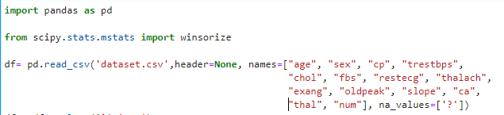
Importing the Dataset using Panda

Slide 6
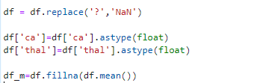
Handling the missing values

Slide 7


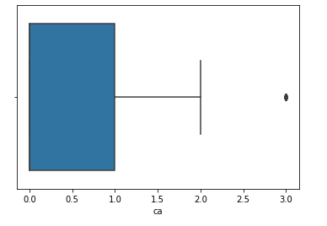
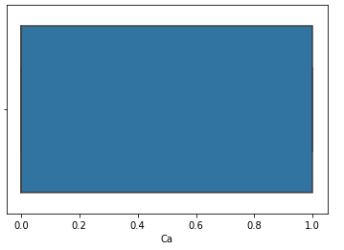
Detecting and modifying outliers

Slide 8

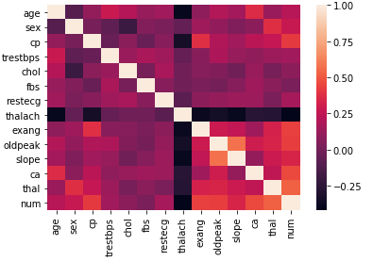
Correlation between the independent and dependent attributes

Slide 9
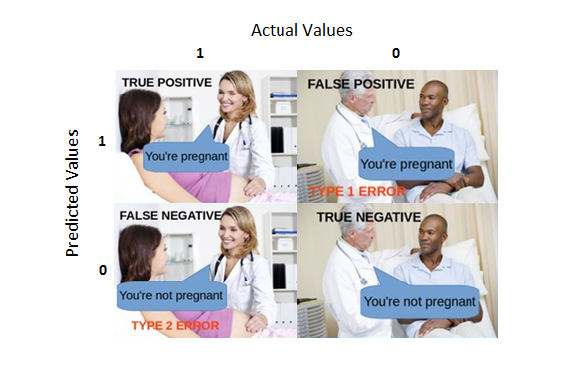
Confusion Matrix
True Positive:
Interpretation: You predicted positive and it’s true.
You predicted that a woman is pregnant and she actually is.
True Negative:
Interpretation: You predicted negative and it’s true.
You predicted that a man is not pregnant and he actually is not.
False Positive: (Type 1 Error)
Interpretation: You predicted positive and it’s false.
You predicted that a man is pregnant but he actually is not.
False Negative: (Type 2 Error)
Interpretation: You predicted negative and it’s false.
You predicted that a woman is not pregnant but she actually is.

Slide 10

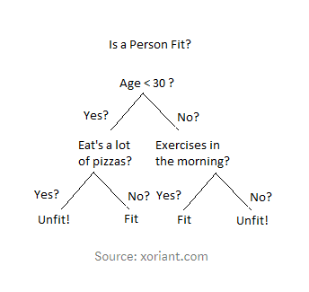
Decision Tree Classifier
A Decision Tree is a simple representation for classification problems. It is a Supervised Machine Learning where the data is continuously split according to a certain parameter.

Slide 11
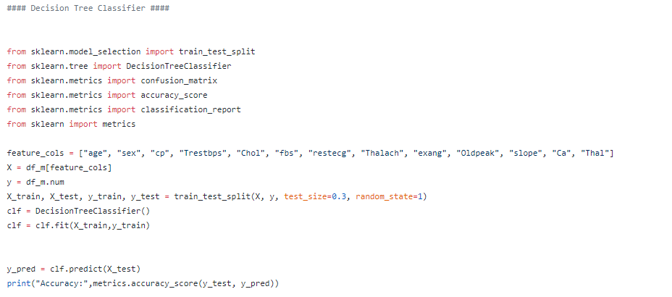
Decision Tree Classifier

Slide 12
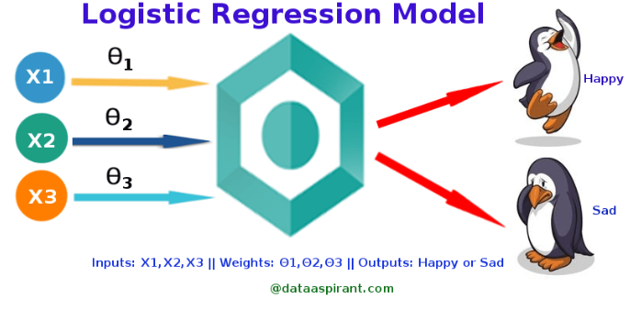
Logistic Regression
Logistic regression is a statistical method for analyzing a dataset in which there are one or more independent variables that determine an outcome.
The outcome is measured with a dichotomous variable (in which there are only two possible outcomes).
It is used to predict a binary outcome (1 / 0, Yes / No, True / False) given a set of independent variables.

Slide 13
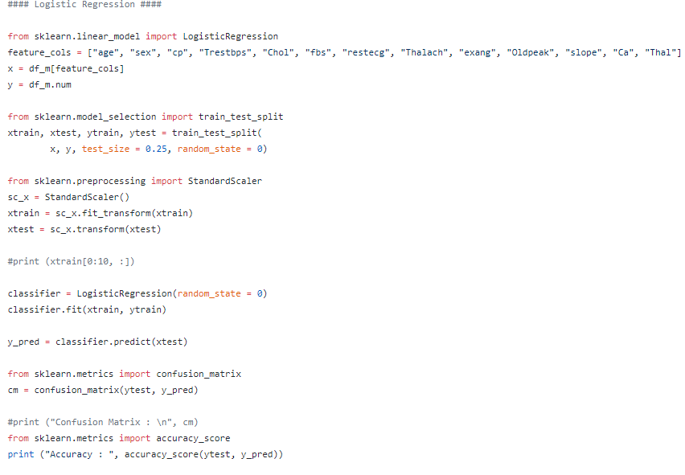
Logistic Regression

Slide 14

Random Forest
The fundamental idea behind a random forest is to combine the predictions made by many decision trees into a single model. Individually, predictions made by decision trees may not be accurate but combined together, the predictions will be closer to the true value on average.
It works on large collection of decorrelated decision trees. We create random subsets of the main dataset. Voting is done to find most predicted values.

Slide 15
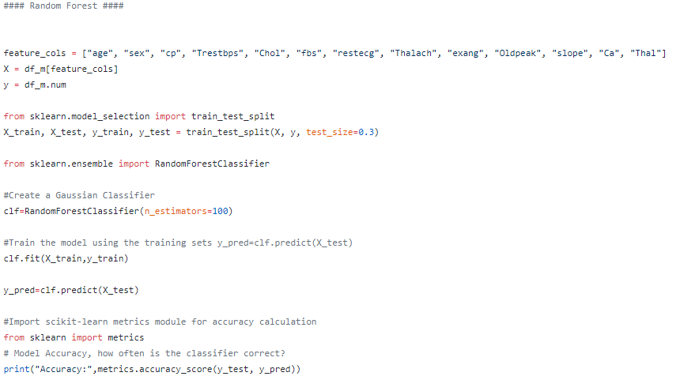
Random Forest

Slide 16

Naïve Bayes
Naive Bayes is a probabilistic machine learning algorithm based on the Bayes Theorem, used in a wide variety of classification tasks
Typical applications include filtering spam, classifying documents, sentiment prediction etc.

Slide 17
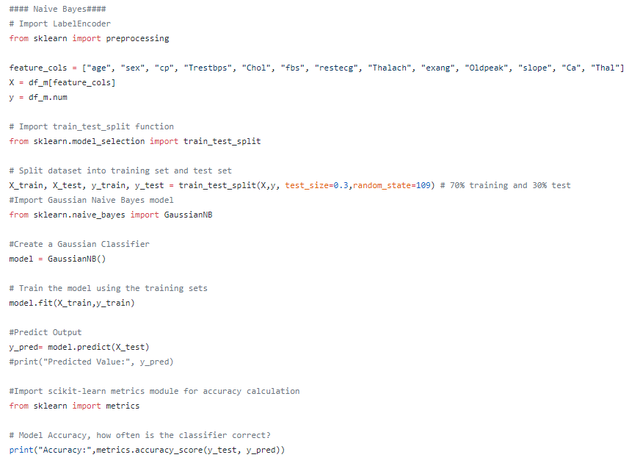
Naïve Bayes

Slide 18
Conclusion
Based on the results we got from the above given algorithms, we can easily say that Random Forest algorithms worked best with our given dataset.
Decision Trees is a great algorithm, nevertheless, just one run on the data will probably not return the best prediction.
This is the basis of Ensemble Learning and thus Random Forest.

Slide 19


